Slide 1
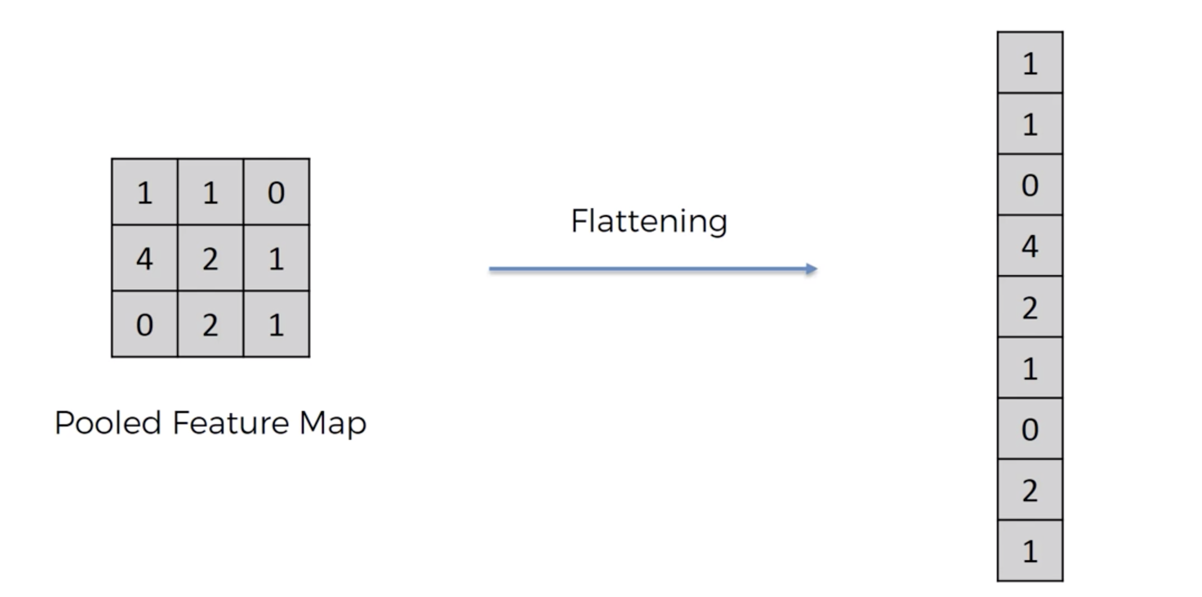
1
One big column with all max pooled maps flattened
2

